Slide 1






KONGU ENGINEERING COLLEGE
PERUNDURAI ERODE-638060
DEPARTMENT NAME
KEC IDEATHON
REAL TIME TRAFFIC INTENSITY BASED MESSAGE BOARDS
Team Lead: Karthiga K(20ECR073)
Team Members: Karteeswar K P ( 20ECR071)
Lathika M V( 20ECR088)
Technology Readiness Level: TRL – 2(TECHNOLOGY CONCEPT FORMULATED)
Team Mentor with Designation and Department:
Mr.G.THIRUNAVUKKARASU,M.E.,(Ph.D),
Assistant Professor,
Department of Electronics and Communication Engineering
Kongu Engineering College,Perundurai,
Erode – 638060.
In association with:

Slide 2


The Problem
The increasing traffic congestion has become a major problem in many of the developing metropolitan areas across the globe.
Peak hour traffic congestion has become something everyone has to face due to the way in which the current society operates.
Traffic congestion affects
travel costs
travel time
mobility
accessibility
productivity
air pollution

Slide 3
The Solution
This project aims to design a model to reroute the traffic to the roads with less vehicles in the traffic signal queue. It is planned to use image processing technique to estimate the traffic density in the ahead road.
This information typically through intelligent transportation systems and a regional traffic management center (TMC) that manages the system.
Vehicle detection and statistics in traffic monitoring system are of considerable significance to intelligent traffic management and control of the roadway traffic control.

Slide 4
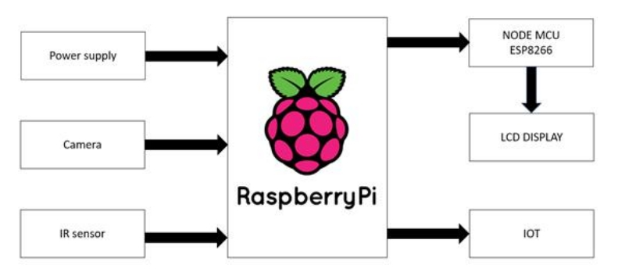
Flowchart / Product workflow

Slide 5
Competitors
We’ve all seen the them at one time or another while motoring down a road or highway. Known as traffic message boards, this portable signage is deployed in a variety of traffic control situations.
In other countries these traffic message boards are used to display the accidents, safety measures and the traffic rules.
In our project we use these message boards to display the traffic congestion , number of vehicles in the traffic and the approximate time for the clearance of the traffic.
These boards will be visible for long distance upto the ttrafc congestion.
This will be used as an indication for the drivers in the traffic and will be used to reduce the waiting time of the people stuck in the traffic.

Slide 6
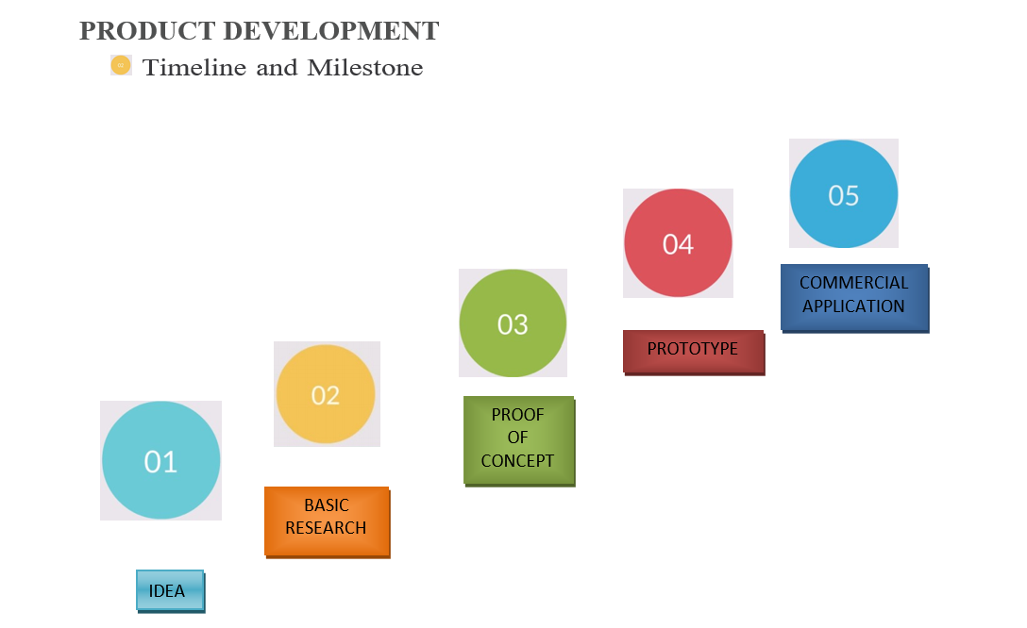
Idea - Current Status / Future Plan
TRL-2 (BASIC RESEARCH)

Slide 7
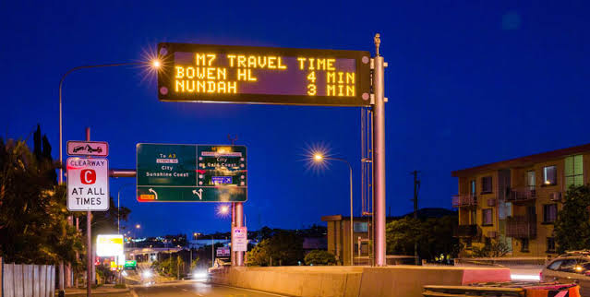
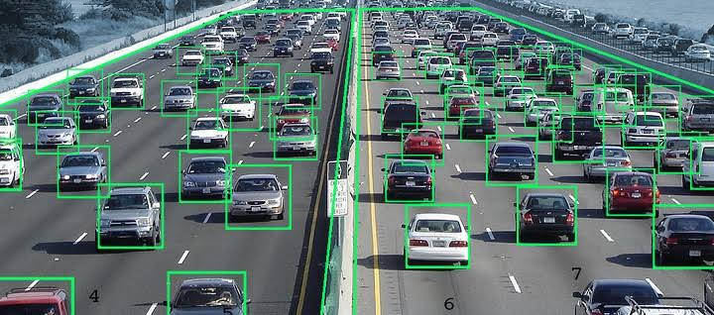
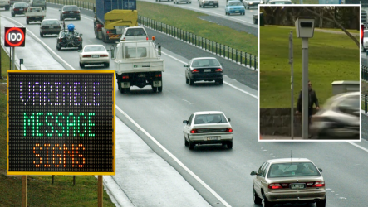
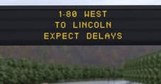
Uniqueness / IP:
The information obtained from the process is displayed on the message boards on the sides of the road.
Message boards are digital signs that are placed by the road for drivers to see.
In many cases, using a traffic message board to communicate a slowdown or accident on a major highway actually leads to reduced traffic by encouraging drivers to seek alternate routes

Slide 8
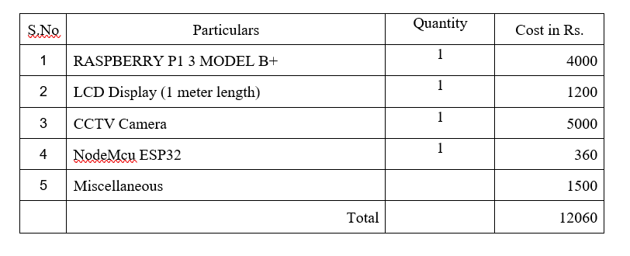
VALUE PROPOSITION

Slide 9
Thank You !!

